Slide 1
Applied Data Science Capstone Project
Consulting a New York business to extend its activity to Toronto

Slide 2
Introduction
More and more Businesses are looking to expand their activities in new places.
Most companies looking to expand into new markets want to boost their sales and have identified a market in which they can see the potential for growth.

Slide 3
Business Problem
Due to the congested New York City a lot of businesses have come to us asking how to expand their activities in new places even it means to move to a new country. Depending on the market growth and news, Toronto is a city that is growing in a rapid tempo.
So as a consulting company we decided to make an analysis on the boroughs of New York and Toronto to see how close these cities are to each other in terms of market style and chances so that we can propose to our customers to move there.

Slide 4
Data Acquisition and Presentation
IBM Developer Skills Network
Wikipedia
https://en.wikipedia.org/wiki/List_of_postal_codes_of_Canada:_M
Request get url
Pandas read csv
Beautiful soup- webscrapping

Slide 5
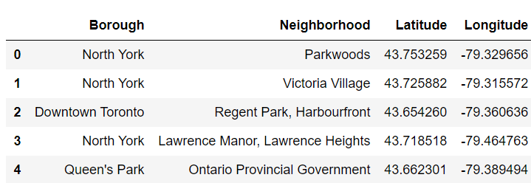
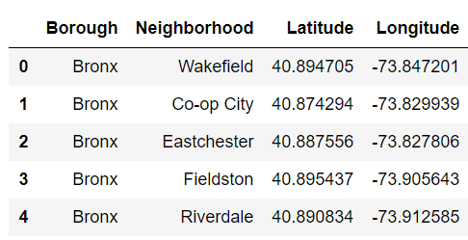
Dataframes
NEW YORK DATA
TORONTO DATA

Slide 6
EDA (Exploratory Data Analysis)
Plotting the amount of neighbors each Borough consists of

Slide 7
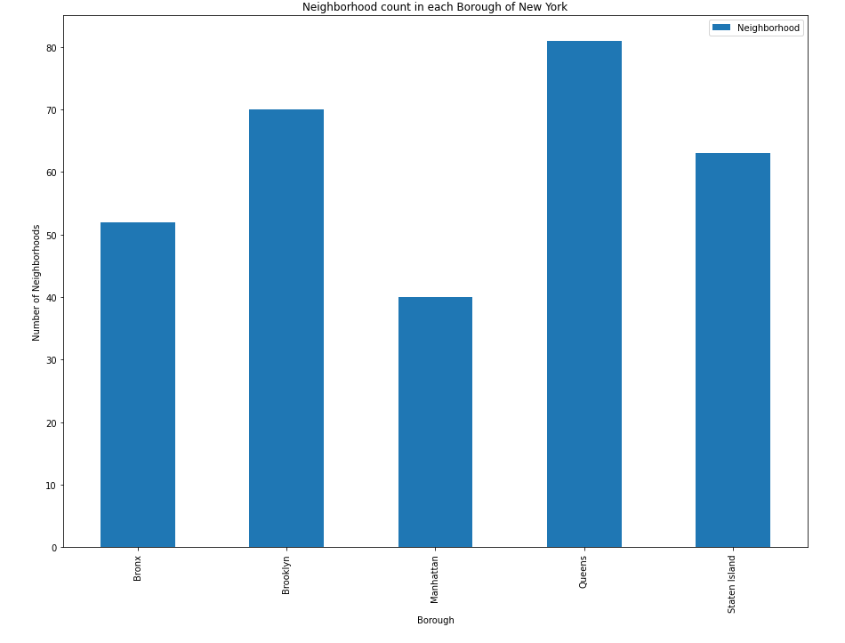
Ney York
Neighbors in each Borough

Slide 8
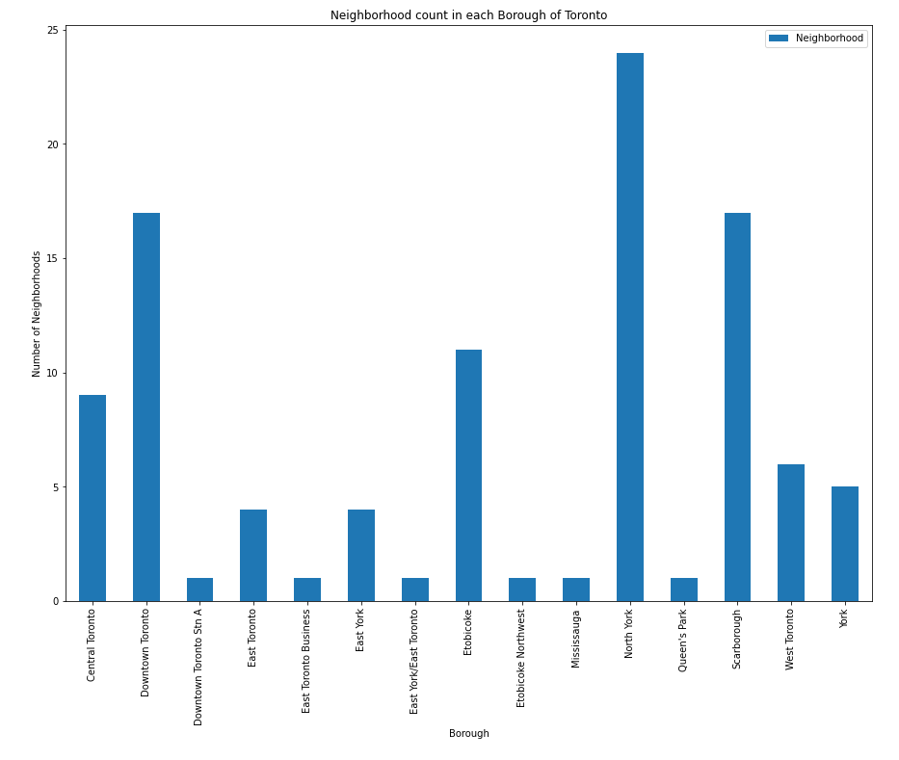
Toronto
Neighbors in each Borough

Slide 9
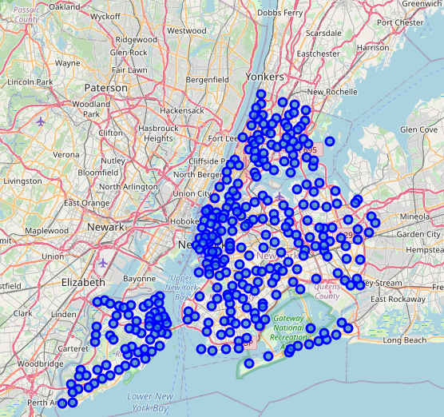
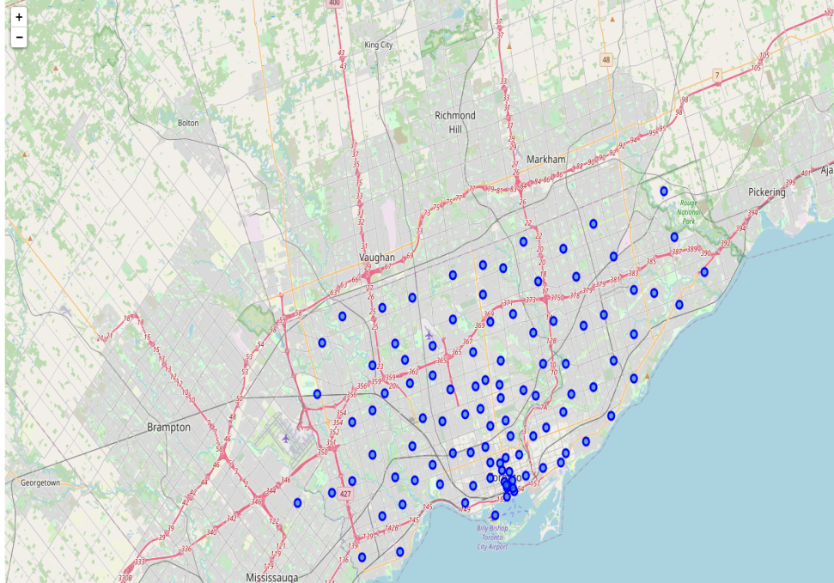
City maps with neighbors
New York
Toronto

Slide 10
Acquire the Venues using the Foursquare API
Foursquare API utilization
Get the venue categories
Store it in the dataframe

Slide 11
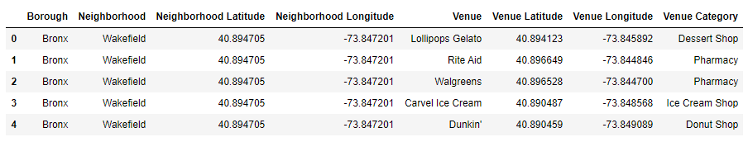
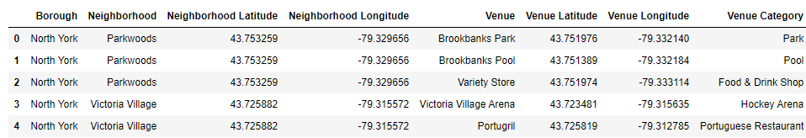
New York
Toronto

Slide 12
Compare the two Cities
Create a regression plot to see the relationship between the neighbors and the venues each city has

Slide 13
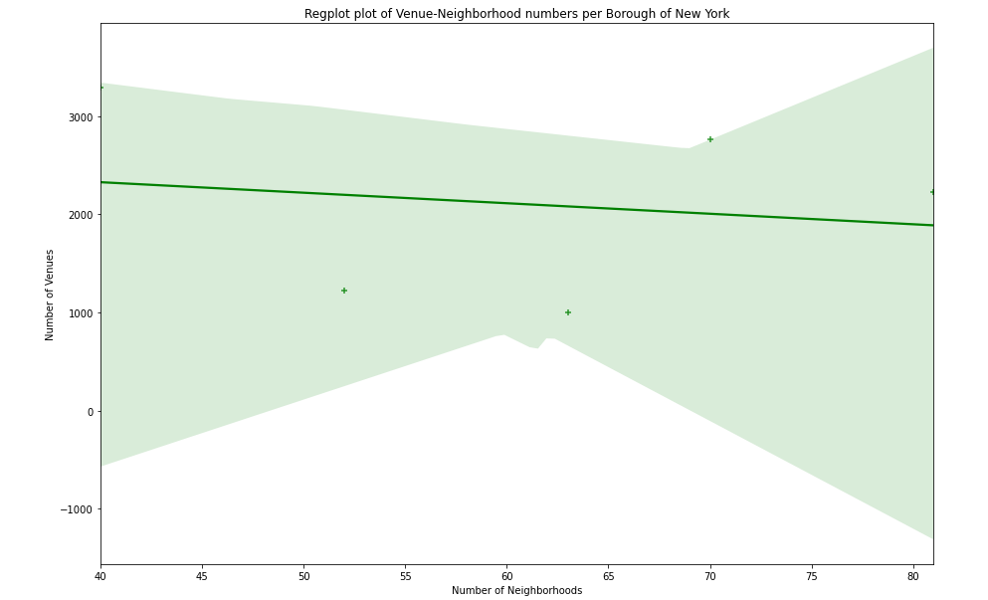
New York
Slightly negative relation

Slide 14
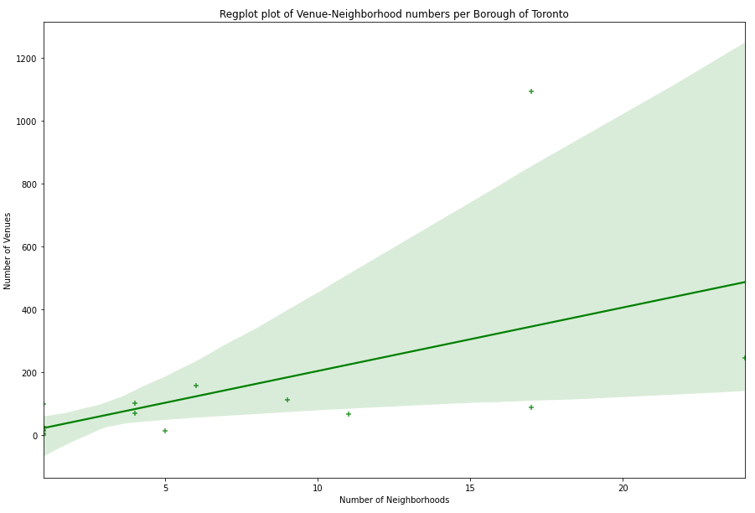
Toronto
Slightly positive relation

Slide 15
Modeling preparation
We perform one hot encoding to get the best 10 venue categories of each borough
Store in a dataframe in descending order
Elbow method to pick the right number of clusters to use the K-Means method

Slide 16
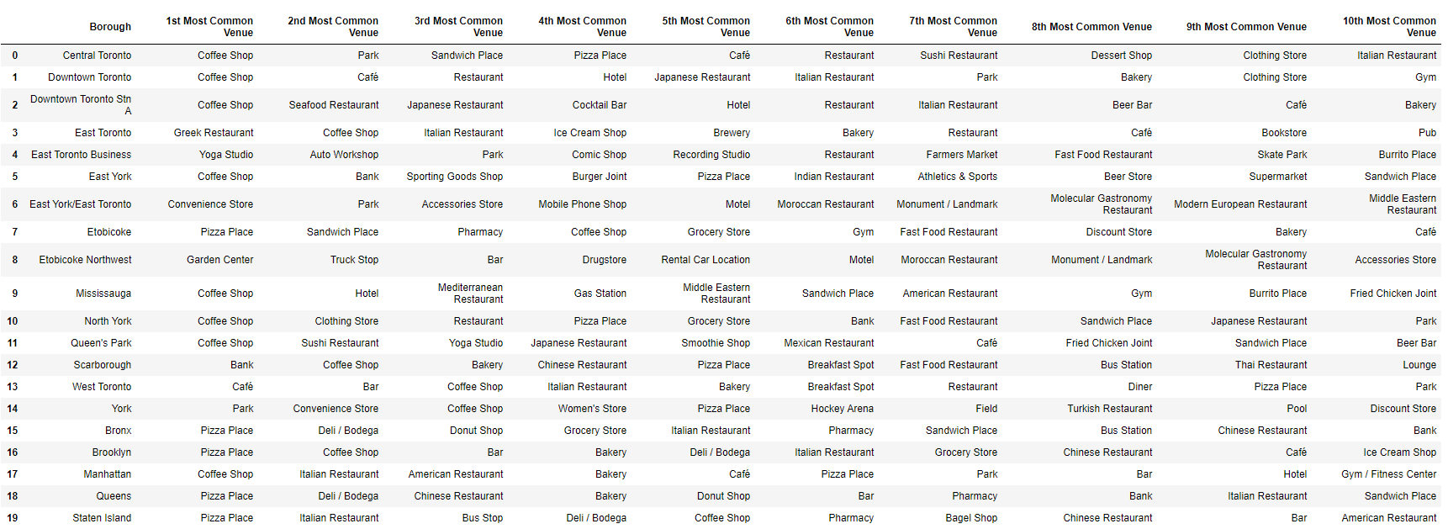
Table with the most common venues

Slide 17
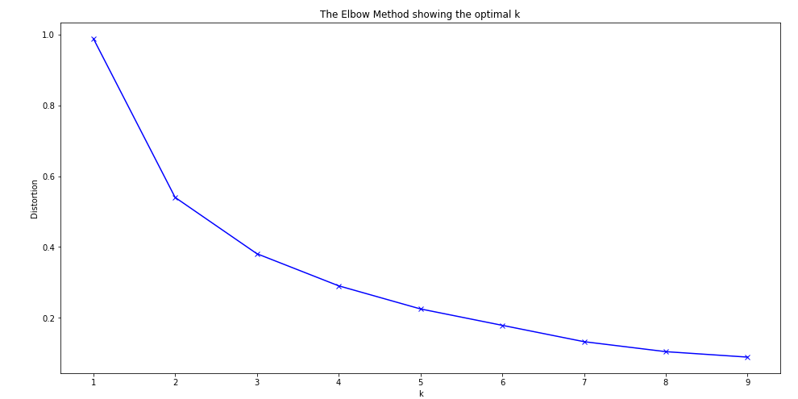
Elbow Method to decide which K fits the most
Number 3 is the optimum choice

Slide 18
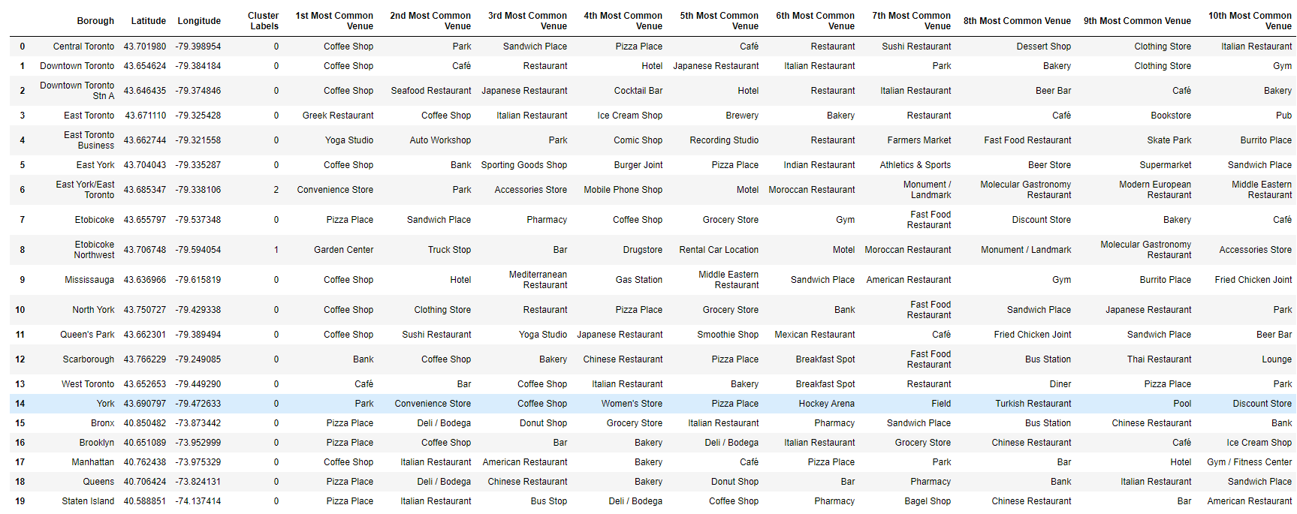
Results
The above table shows each borough for both cities with the 10 most common category venues per borough as well as the cluster that each borough fits in.

Slide 19
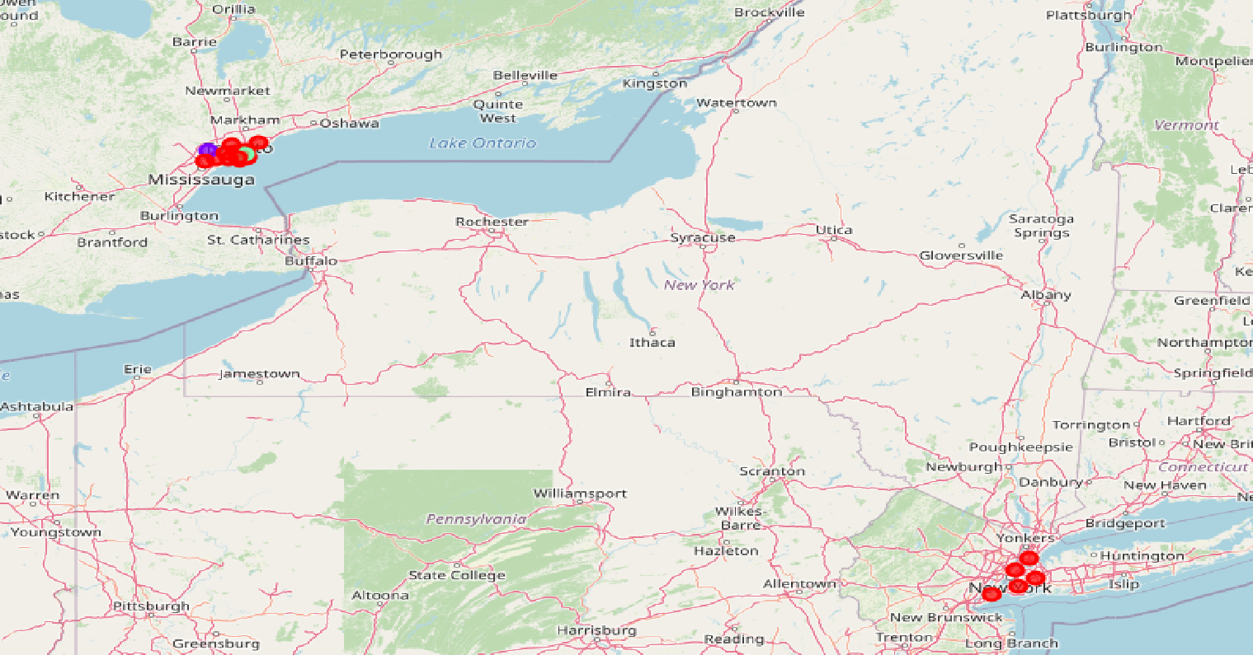
Map Of the Clustered Boroughs

Slide 20
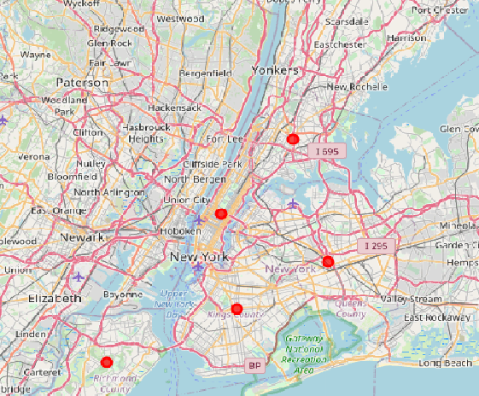
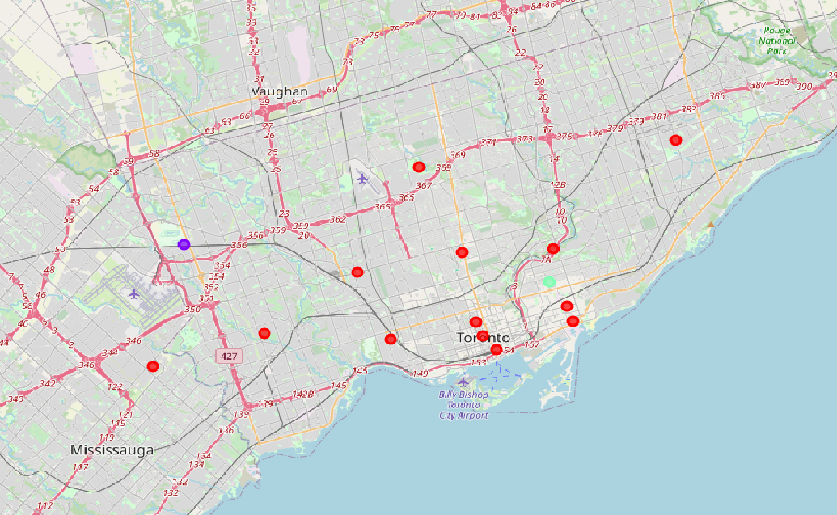
Comparison
New York
Toronto
As we can see clearly these two cities are very similar
. Toronto is a city which the majority of it’s boroughs are very common with the New York city

Slide 21
Conclusion
In this project an attempt has been made to make use of the Foursquare API to get the most common venues for each borough of the two requested cities in order to compare them and find out how close they are to each other. The way to find this out is by utilizing the k-means method in order to cluster the boroughs and make some comments on the results. Every customer who thinks of expanding his business from New York to Toronto can now be assured of the circumstances and can decide e.g. If he needs to expand on a Borough with the same opportunities or in a market that his sector is not so common yet.

Slide 22
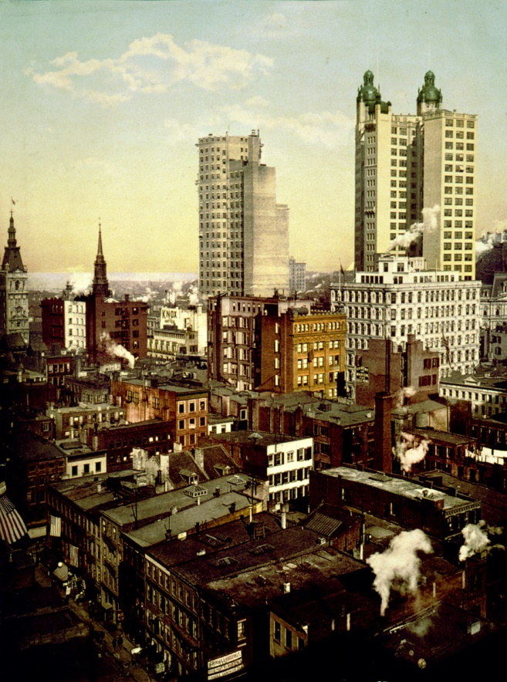
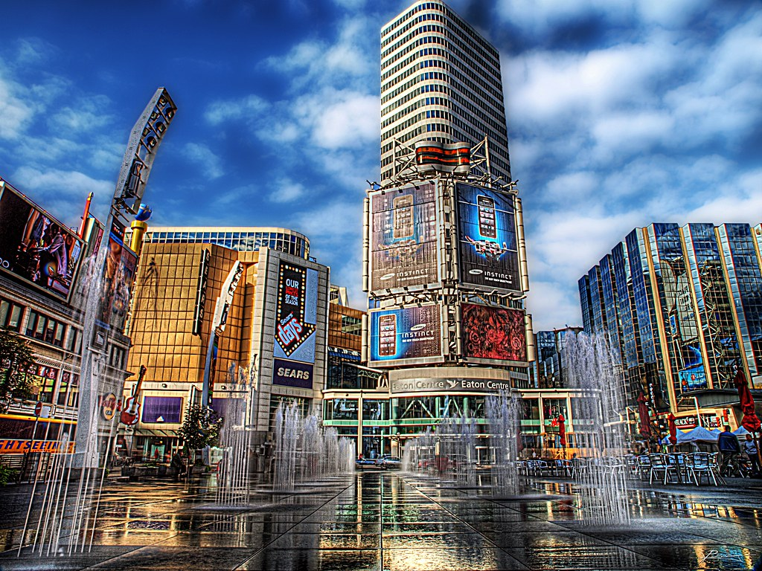
Thank you!

